Slide 1


BN College Of Pharmacy
PRESENTATION
ON
Industrial Training of
Parenteral Preparation
Jedux Parenteral Pvt. Ltd. (U.P.)
PRESENTED BY:- SUBMITTED TO:-
Sarfraj Ansari Mr. Virendra Kumar Singh
B.Pharm 3rd Year VI (HOD Pharmacy Dept.)

Slide 2
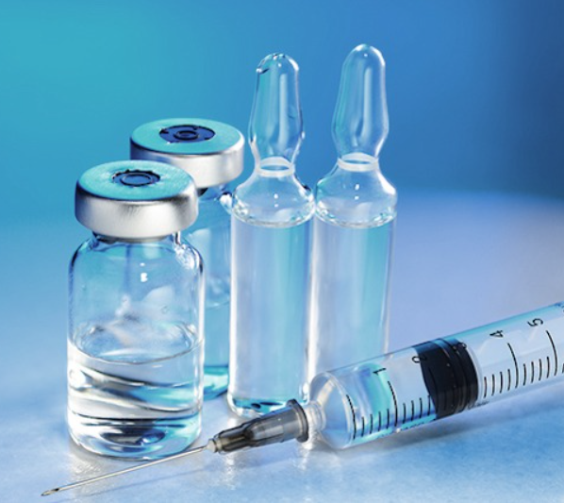
Introduction to Parenteral Preparation
Parenteral preparation refers to the compounding and manufacturing of sterile drug products that are administered by injection, infusion, or other parenteral routes. This process requires strict aseptic techniques and specialized equipment to ensure the safety and efficacy of the final product.

Slide 3


Importance of Industrial Training
Industrial training is crucial for ensuring the safe and efficient production of parenteral preparations. It equips workers with the specialized skills and knowledge needed to adhere to strict aseptic techniques, regulatory guidelines, and quality control measures. This training is essential for maintaining the sterility and integrity of these critical drug products.
Comprehensive industrial training also empowers workers to properly operate specialized equipment, navigate cleanroom protocols, and handle hazardous materials. This hands-on experience is vital for minimizing risks and producing high-quality, patient-safe parenteral medications.

Slide 4

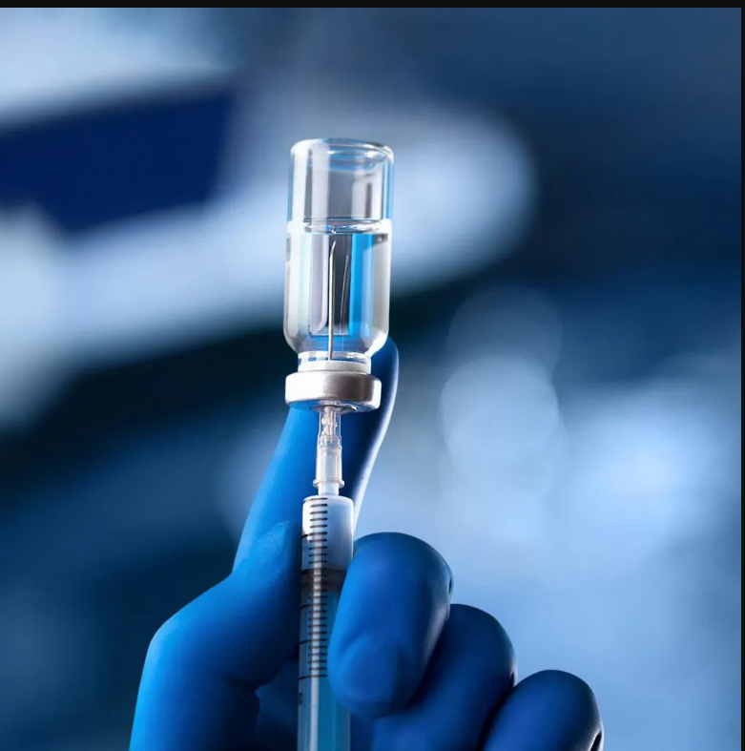
Regulatory Guidelines for Parenteral Preparation
Current Good Manufacturing Practices (cGMP): Adhere to stringent guidelines set by regulatory bodies like the FDA for the proper manufacturing, packaging, and testing of parenteral drugs.
Clean Room Standards: Comply with ISO and EU GMP requirements for cleanroom classification, airflow, temperature, and humidity control to maintain aseptic conditions.
Validation Protocols: Thoroughly validate critical processes like sterilization, filtration, and lyophilization to ensure the consistent production of sterile, high-quality parenteral products.

Slide 5


Aseptic Technique and Sterile Compounding
Maintaining strict aseptic technique is critical for the sterile compounding of parenteral preparations. This involves thorough hand hygiene, gowning in sterile garments, and working within a controlled, ISO-classified cleanroom environment.
Sterile compounding also requires the use of specialized equipment like laminar airflow workbenches, isolators, and closed-system transfer devices to minimize the risk of microbial contamination. Rigorous staff training and adherence to standardized operating procedures are essential.

Slide 6
Cleanroom Requirements and Classifications
ISO Cleanroom Classification
Airflow and Pressure
Material and Personnel Flows
Environmental Monitoring
Parenteral preparation requires ISO-classified cleanrooms ranging from ISO Class 5 to ISO Class 8, depending on the specific product and process needs. These classifications dictate stringent air quality, temperature, and humidity control.
Cleanrooms must maintain positive air pressure and unidirectional airflow to prevent the ingress of contaminated air. HEPA filtration and controlled air changes per hour ensure the sterile environment.
Continuous environmental monitoring for particulates, viable microorganisms, and other parameters ensures the cleanroom remains within classification limits. Prompt action is taken to address any deviations.
Strict protocols govern the movement of materials, equipment, and personnel into and within the cleanroom. Gowning, sanitization, and airlocks minimize the introduction of contaminants.

Slide 7
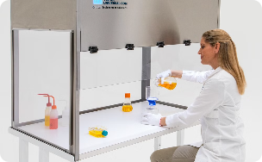
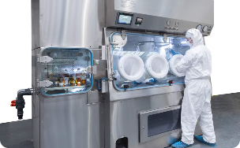
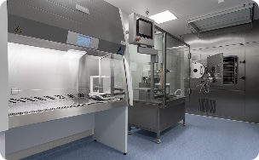
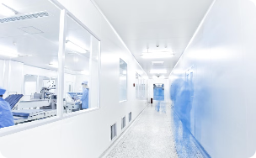
Equipment and Facilities for Parenteral Preparation
Laminar Flow Hoods
Isolators
ISO-Classified Cleanrooms
Specialized Garments
Airtight enclosures that provide an ultra-clean, highly controlled environment for critical aseptic processes and hazardous drug handling.
Specialized workstations with HEPA-filtered, unidirectional airflow to create an aseptic environment for sterile compounding of parenteral drugs.
Strictly controlled environments with specialized HVAC systems, airflow, pressure differentials, and rigorous protocols to maintain microbial purity.
Sterile gowns, gloves, masks, and other protective equipment worn by personnel to prevent contamination during aseptic processes.

Slide 8
Validation and Verification Processes
Process Validation
Extensive testing and documentation to demonstrate that critical manufacturing processes consistently produce parenteral products meeting predetermined quality specifications.
Sterilization Verification
Verification of sterilization parameters, such as time, temperature, and pressure, to confirm the effective elimination of viable microorganisms.
1
2
3
Cleaning Validation
Rigorous cleaning and sanitization protocols validated to ensure complete removal of residues, microorganisms, and other contaminants from equipment surfaces.

Slide 9


Quality Control and Quality Assurance
Robust quality control and quality assurance measures are essential for ensuring the safety, efficacy, and consistency of parenteral preparations. This includes rigorous in-process testing, final product inspections, and comprehensive documentation to verify compliance with regulatory requirements.
In-Process Testing
Final Product Inspection
Documentation Review
Equipment Calibration
Continuous monitoring and testing of critical process parameters, such as sterility, endotoxin levels, and particulate matter, ensures the production of high-quality, patient-safe parenteral medications. Rigorous documentation and record-keeping are also crucial for demonstrating regulatory compliance and enabling effective investigations.

Slide 10
Handling of Hazardous Drugs
Personal Protective Equipment
Closed-System Transfer Devices
Workers must don specialized PPE, including gowns, gloves, masks, and eye protection, to minimize exposure when handling hazardous parenteral drugs.
These innovative devices create a sealed environment to safely transfer hazardous drug products, preventing the release of vapors or aerosols.
Dedicated Compounding Areas
Waste Disposal Protocols
Hazardous drugs are prepared in segregated, negatively pressurized cleanrooms with specialized ventilation to contain any potential contamination.
Strict procedures are followed to safely collect, contain, and dispose of hazardous drug waste, minimizing environmental impact and worker exposure.

Slide 11
Conclusion and Key Takeaways
Robust Industrial Training
Regulatory Compliance
Comprehensive industrial training is essential for ensuring the safety, quality, and consistency of parenteral drug products.
Strict adherence to cGMP guidelines, cleanroom standards, and validation protocols is critical for meeting regulatory requirements.
Aseptic Techniques and Containment
Quality Assurance and Oversight
Rigorous quality control, continuous monitoring, and extensive documentation are vital for ensuring the integrity and safety of parenteral drugs.
Mastering aseptic techniques, utilizing specialized equipment, and implementing robust contamination control measures are key to producing sterile parenteral medications.

Slide 12


